Slide 1
Tecsup Mobile Banking Project

Slide 2
Required Use Cases
Submit Login Request - Mobile/Web
Submit Deposit – Mobile
Submit Withdrawal – Mobile
Submit Transfer – Mobile
Generate Monthly Transactions – Mobile/Web

Slide 3
UML
Use Case Narrative (submitTransferRequest)
Activity Diagram (submitTransferRequest)
Class Diagram
Entity Relationship Diagram

Slide 4
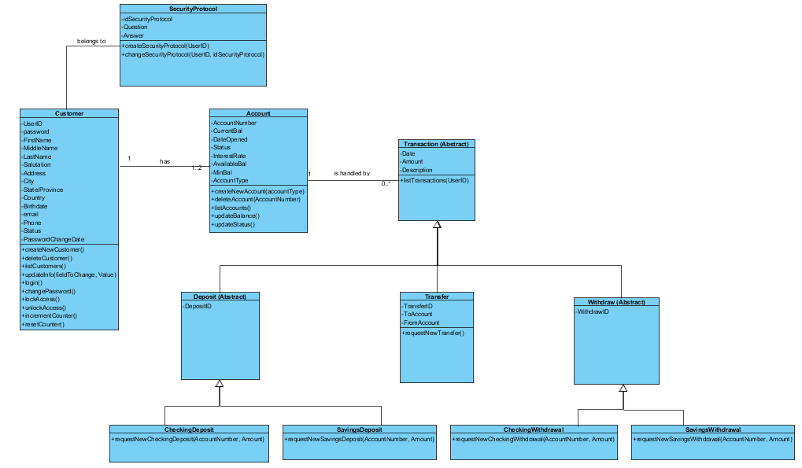
Class Diagram

Slide 5
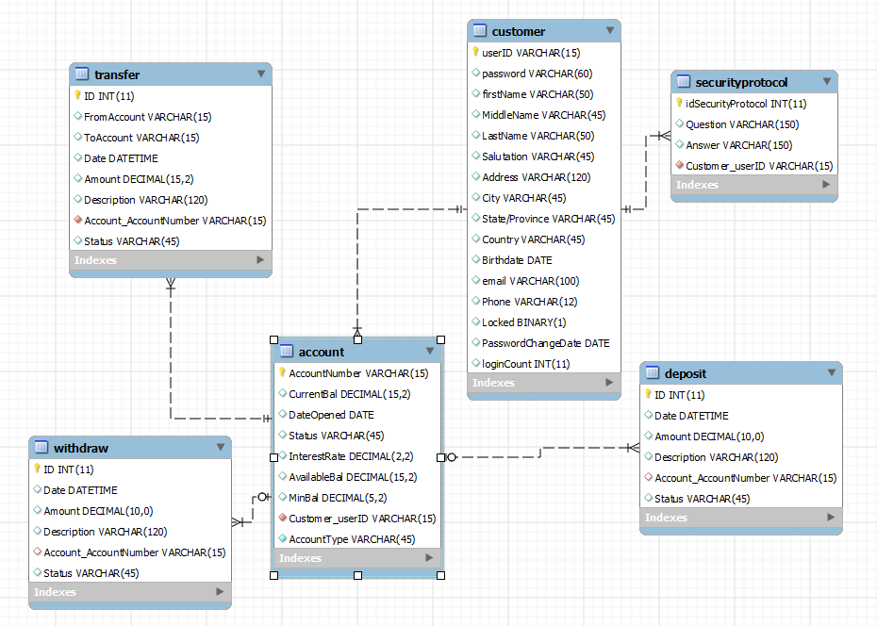
ERD

Slide 6
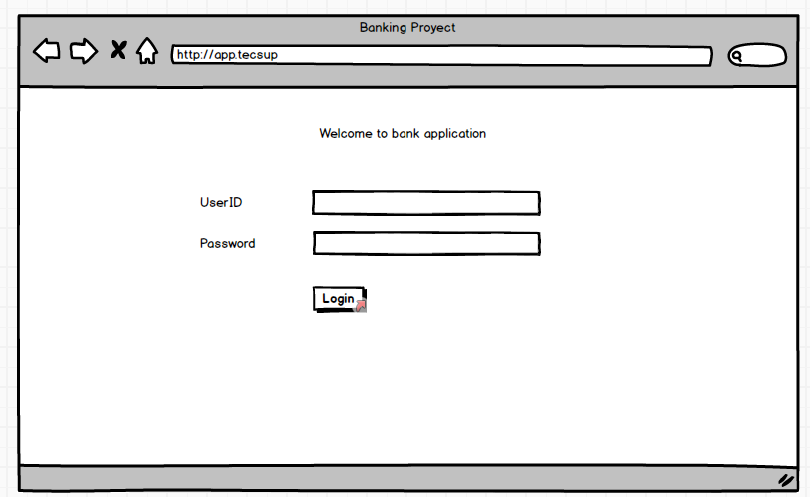
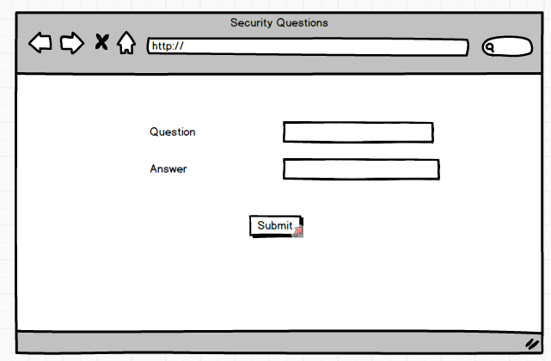
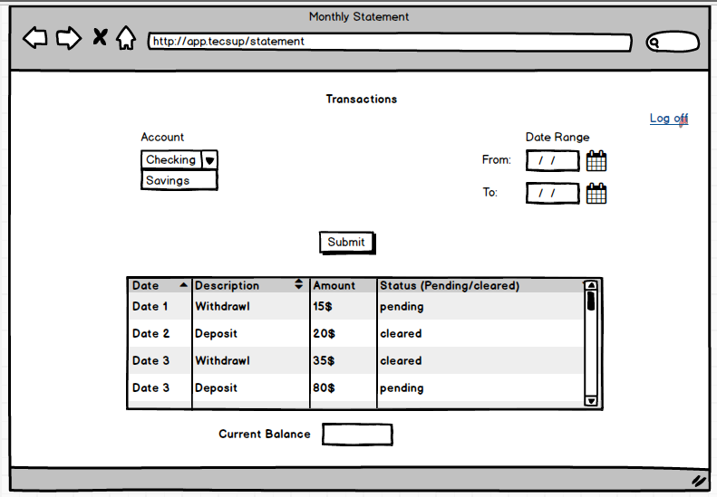
Web Interface Prototypes

Slide 7
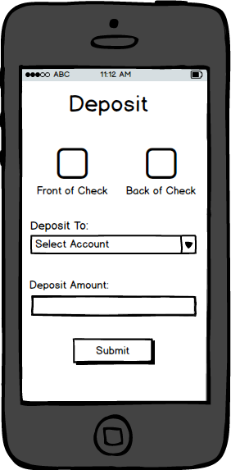
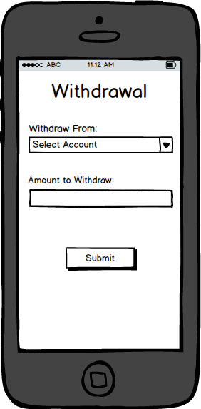
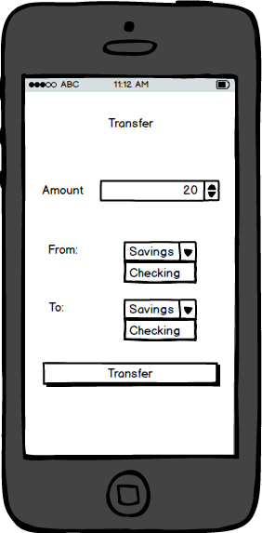
Mobile Interface Prototypes

